Slide 1
Battletech Campaign Operation
By: Austin Karingada
Rogelio Sergio Ramirez III

Slide 2
Introduction
What is this? Battletech is a table top game where you role play as a force (Mercenary, Pirate, Goverment) to take on Contracts given to you. Campaign Operation is a guidebook that will show rules and options for force creation.

Slide 3
Team
Roy Ramirez - made the homepage alongside the registration alongside the database.
Austin Karingada - Was resposible for the wizard which would guide you throughout the Force creation

Slide 4
Problem
The problem is that in the Mercenary Force Creation it would take players 3-4 hours to complete , but with a online web application it can take up to 30 minutes to complete.

Slide 5
Advantages
Players having more time to play the game versus doing accounting, and more importantly, it lowers the barrier for new player introduction of using the Mercenary Creation Rules.

Slide 6
Solution
By creating a web application, it will let users create a Mercenary Force. This app will allow players choose and create their Mercenary Force and this will be stored in the database.

Slide 7
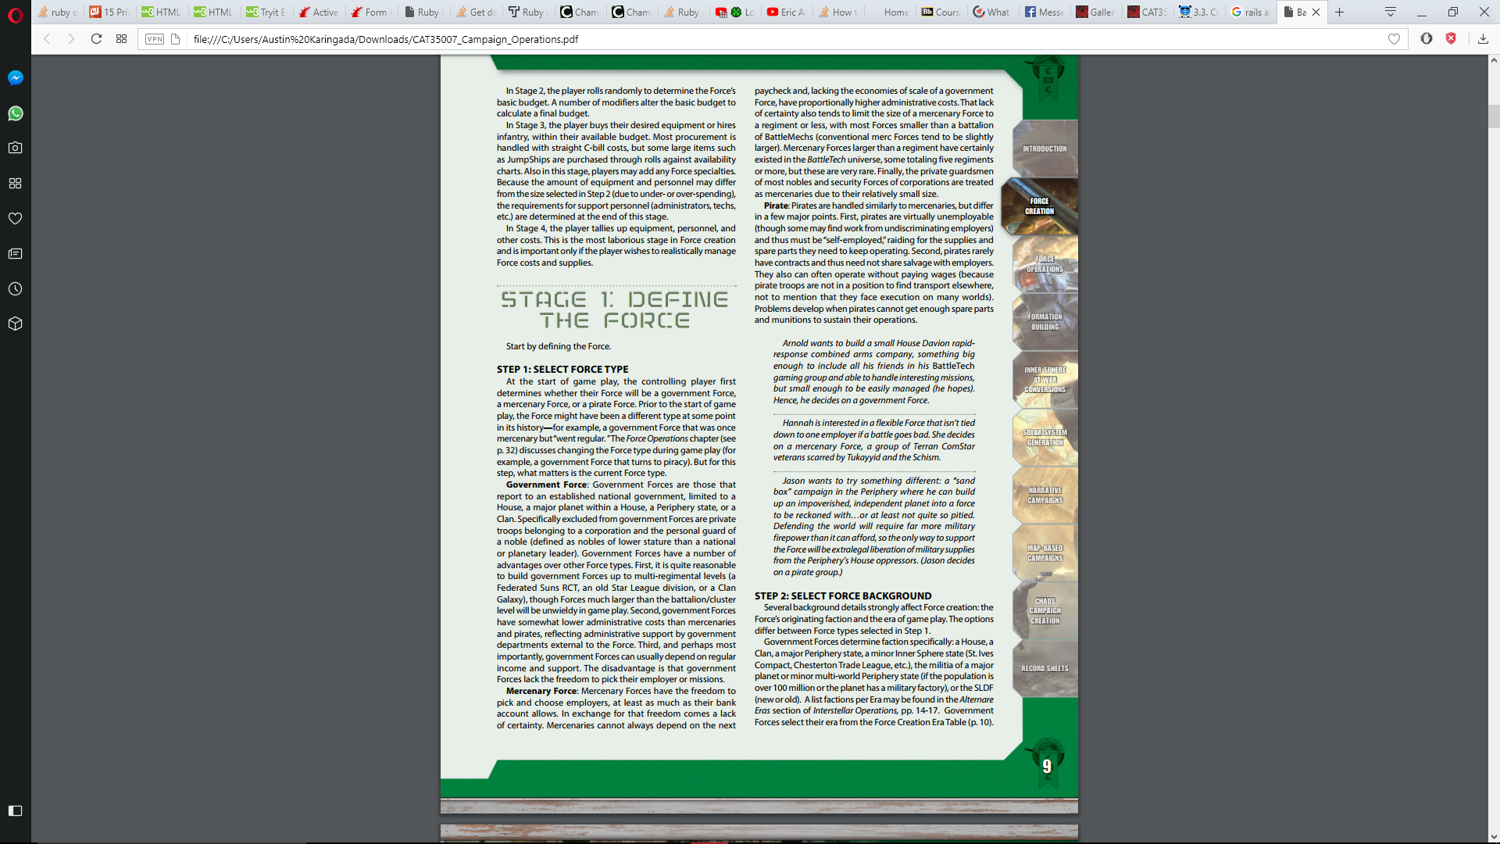
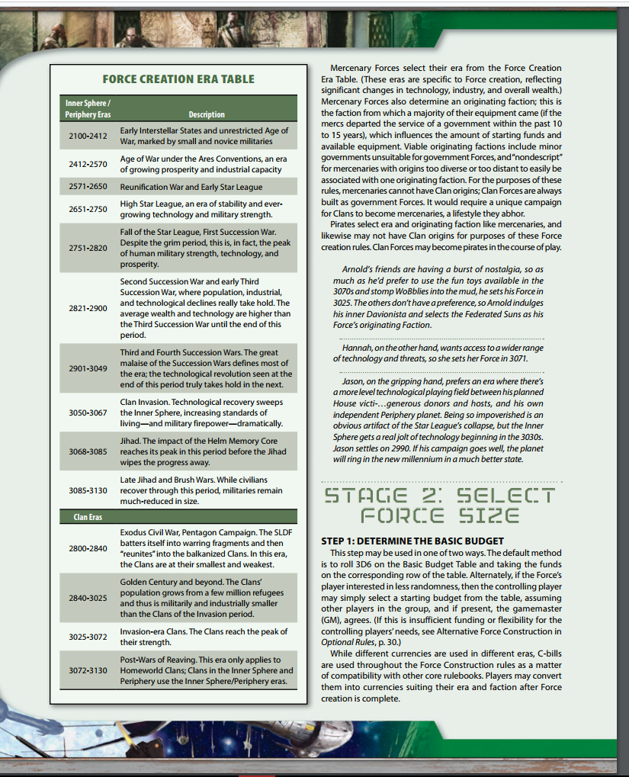
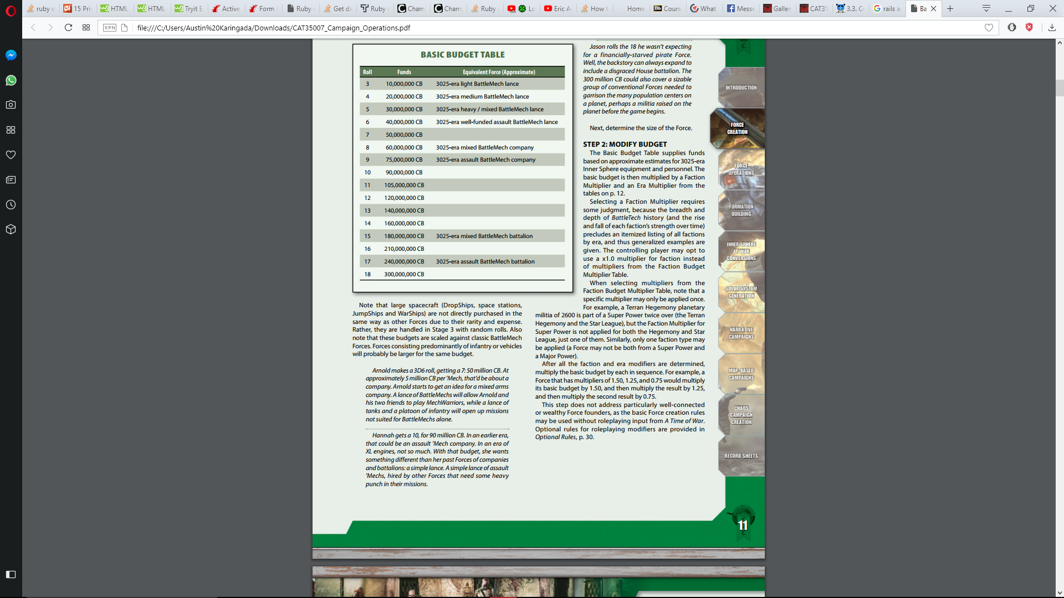
First few pages of rules

Slide 8
Rule Pages
The amount of pages in total for force creation are 21 pages

Slide 9
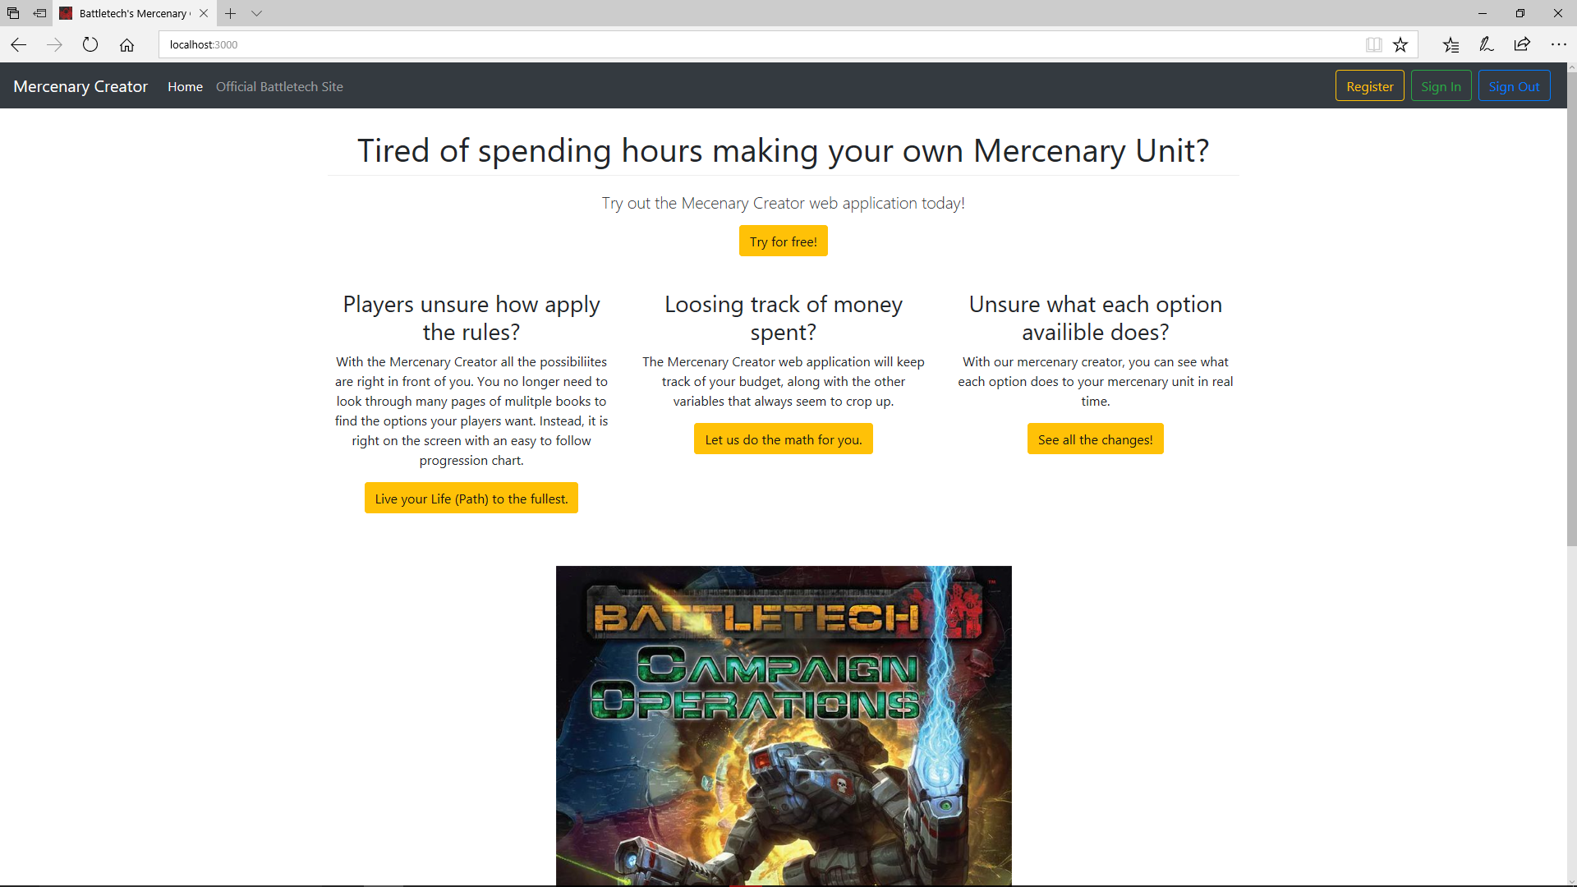
Product :Homepage

Slide 10
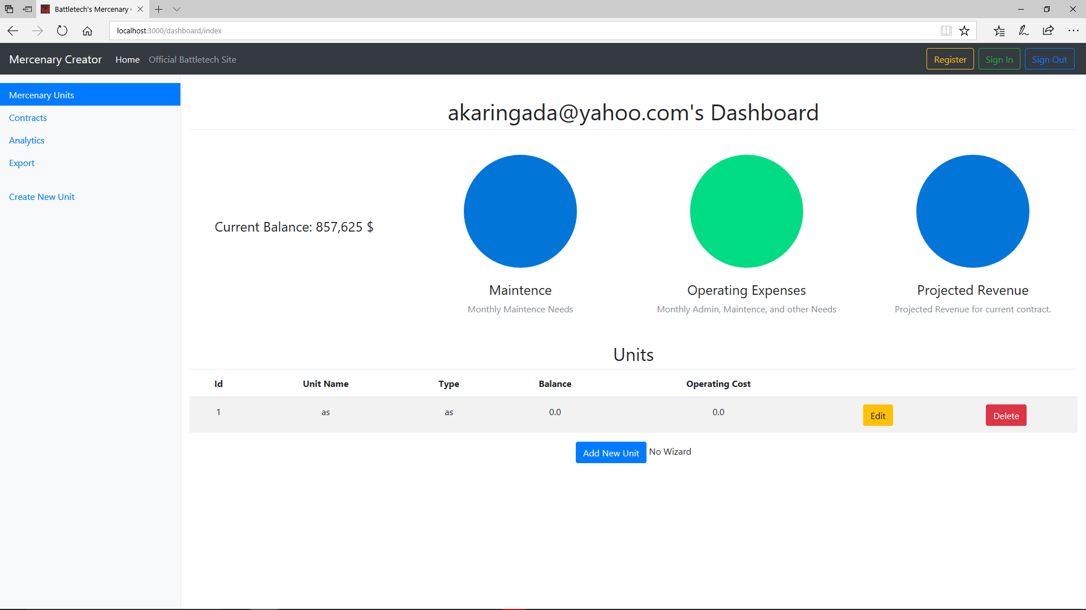
Product: Dashboard

Slide 11
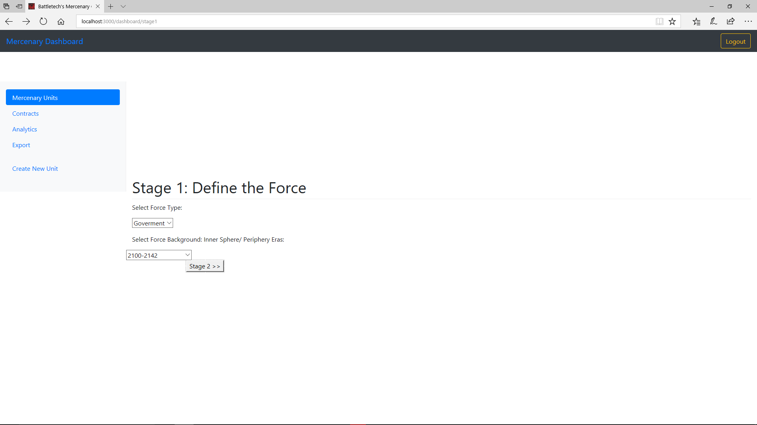
Product: Character Creation

Slide 12
Monetizaton
This service will have a monthly subscription for the users, and when all the rules are added to the application, have a direct sale to the company.

Slide 13
Business Model
Initial costs during development will be none, as free services can be leveraged for testing. After deployment, the costs will be a yearly Domain Name Purchase, and a monthly hosting subscription cost from Heroku ( or other applicable platform) whose price will depend on how many “servers” are needed. The initial price point being 25$ per month.

Slide 14
Contact
For more info or questions email this address:
Austin Karingada
austin.karingada01@utrgv.edu
Rogelio Sergio Ramirez III
rogelio.ramirez01@utrgv.edu

